Slide 1

Your Clan
Families are like fudge – mostly
Sweet with nuts. So create
Your amazing family fudges with us

Slide 2
Your Clan
Your clan is a beautiful user friendly website where users can create there family trees.
These trees are helpful to for keeping the family history intact.
It is often said that, “Family tree has many branches, both living and dead…. But all equally important. People cherish its memories that makes its root deep”.

Slide 3
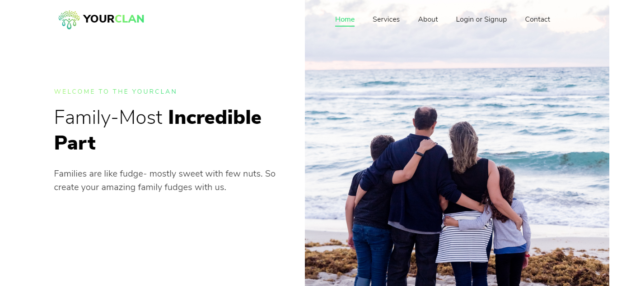
Let’s take a tour…

Slide 4
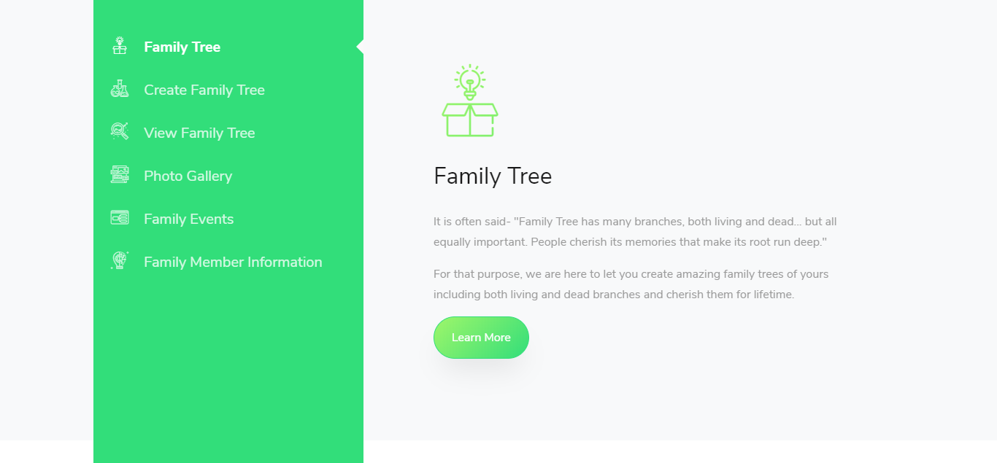

Slide 5
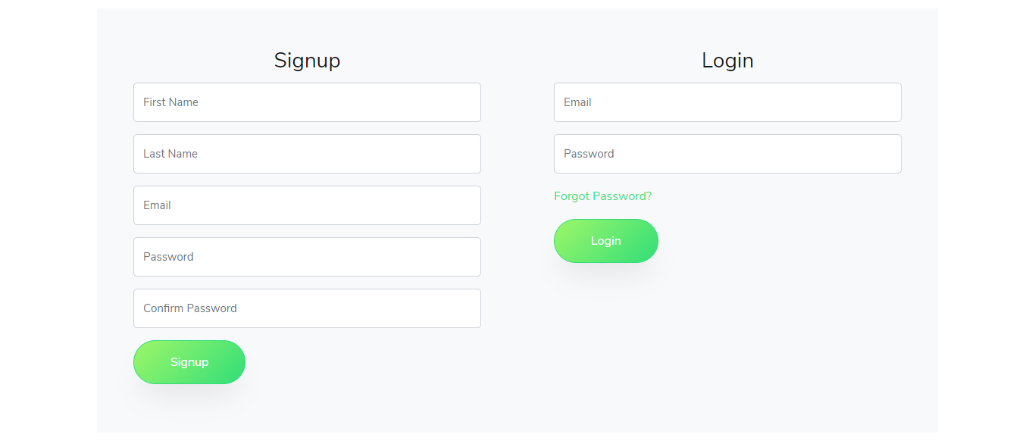
Login Signup Page

Slide 6
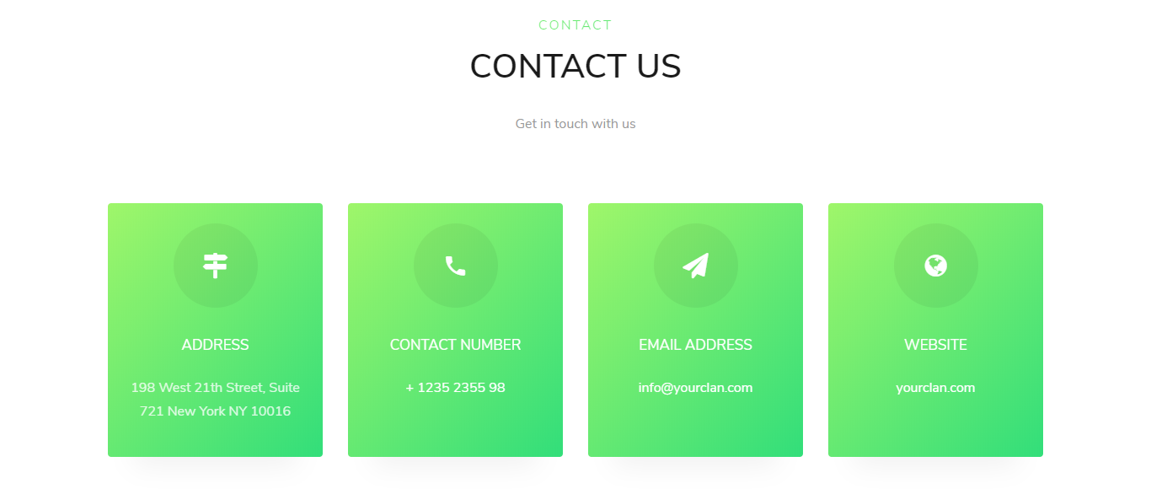
Contact Us

Slide 7
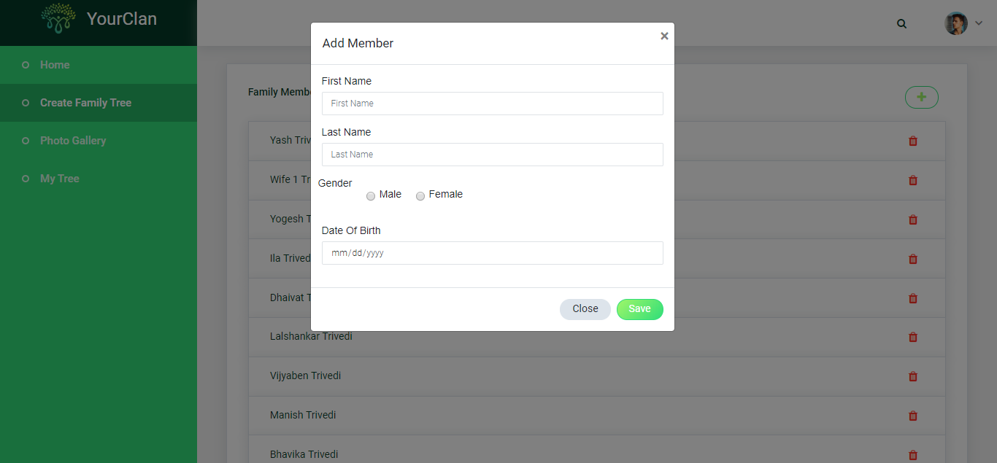
Add Members

Slide 8
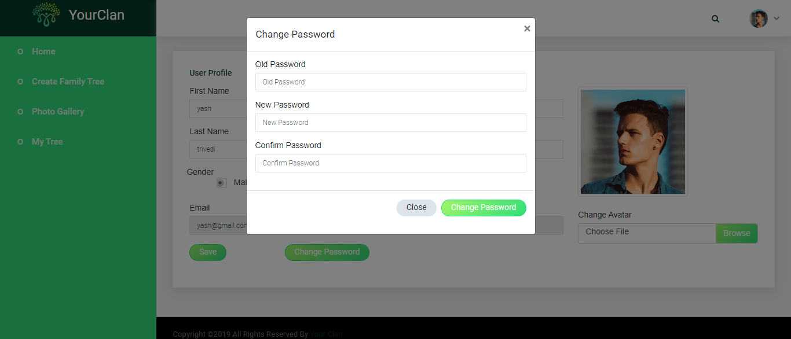
Change Password

Slide 9
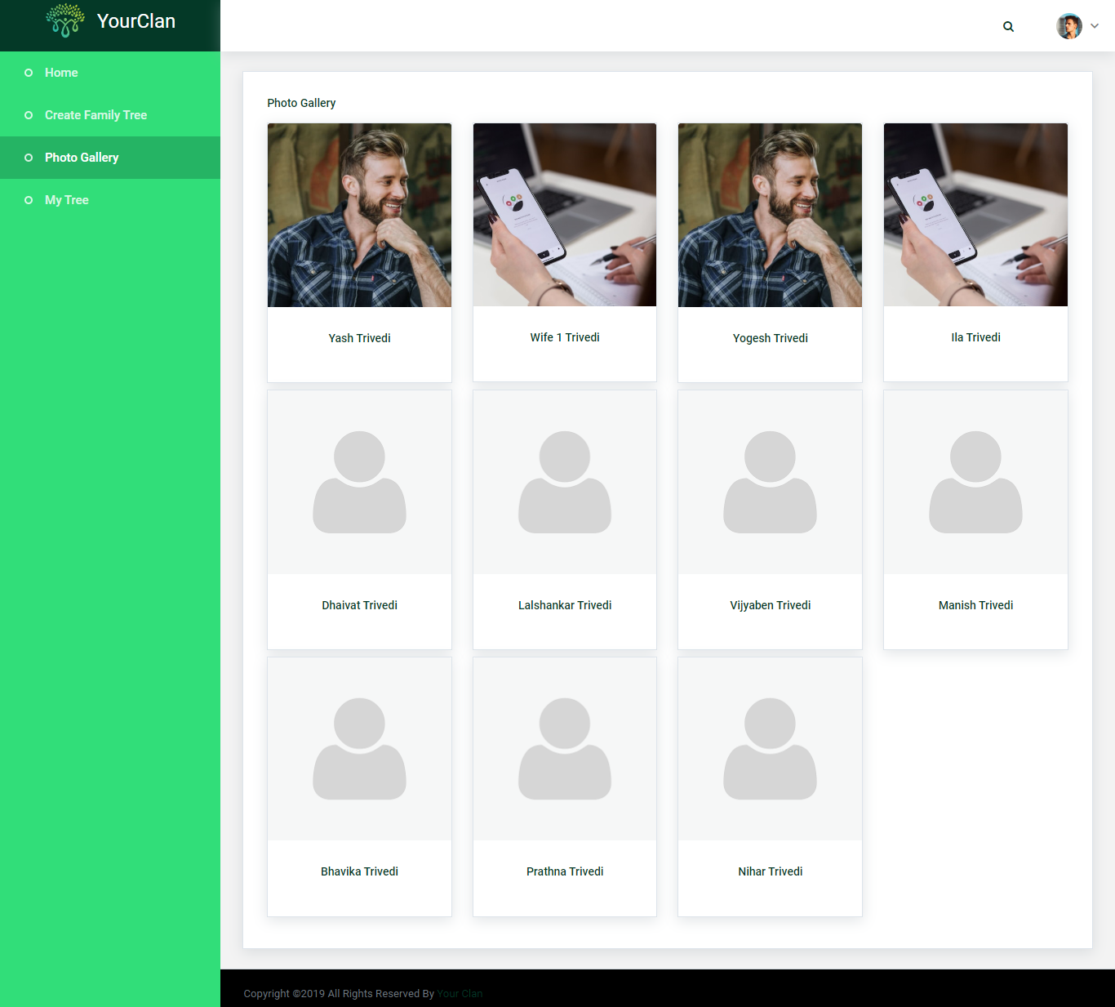
Photo Gallery

Slide 10
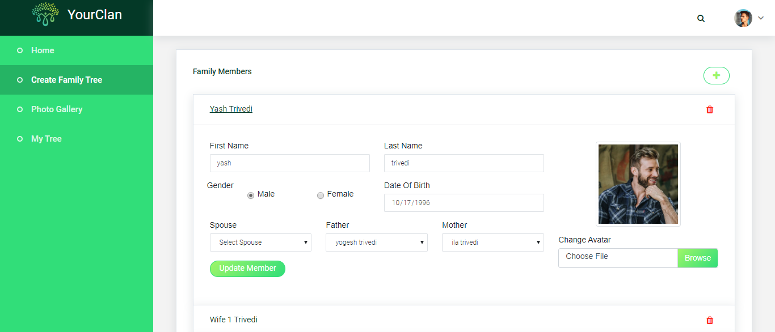
Member Details and update member details

Slide 11
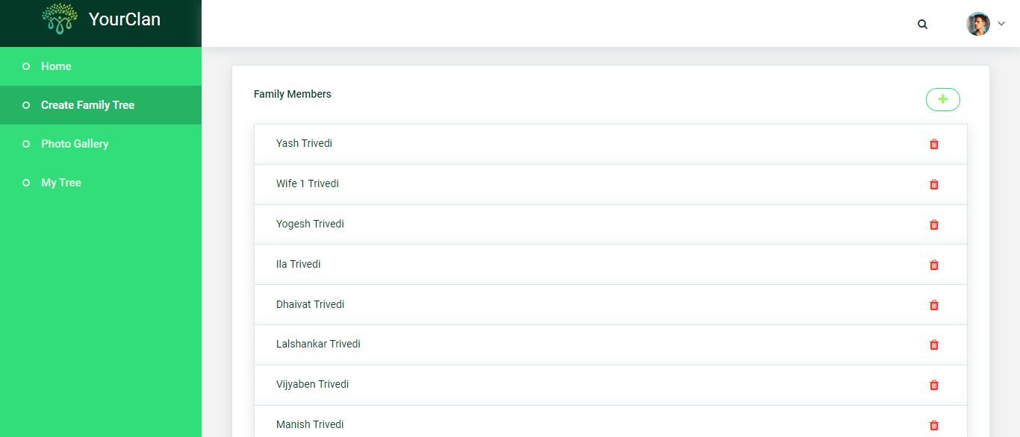
Member List View

Slide 12
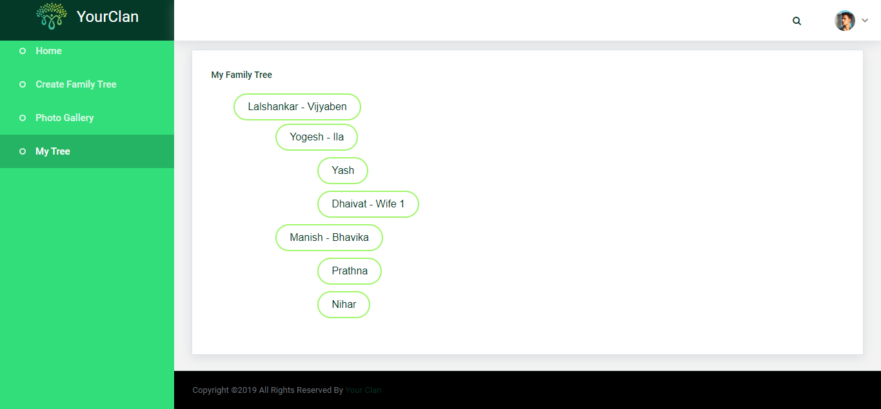
Family tree view

Slide 13
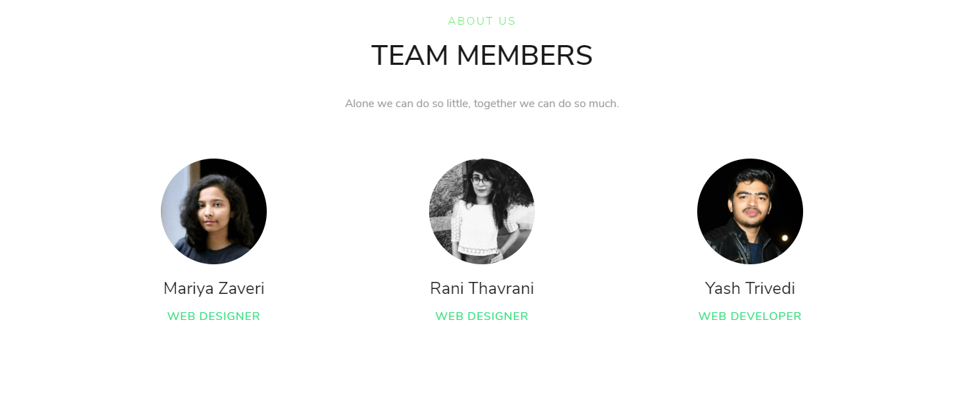
That’s our team

Slide 14
Thank You

